Slide 1
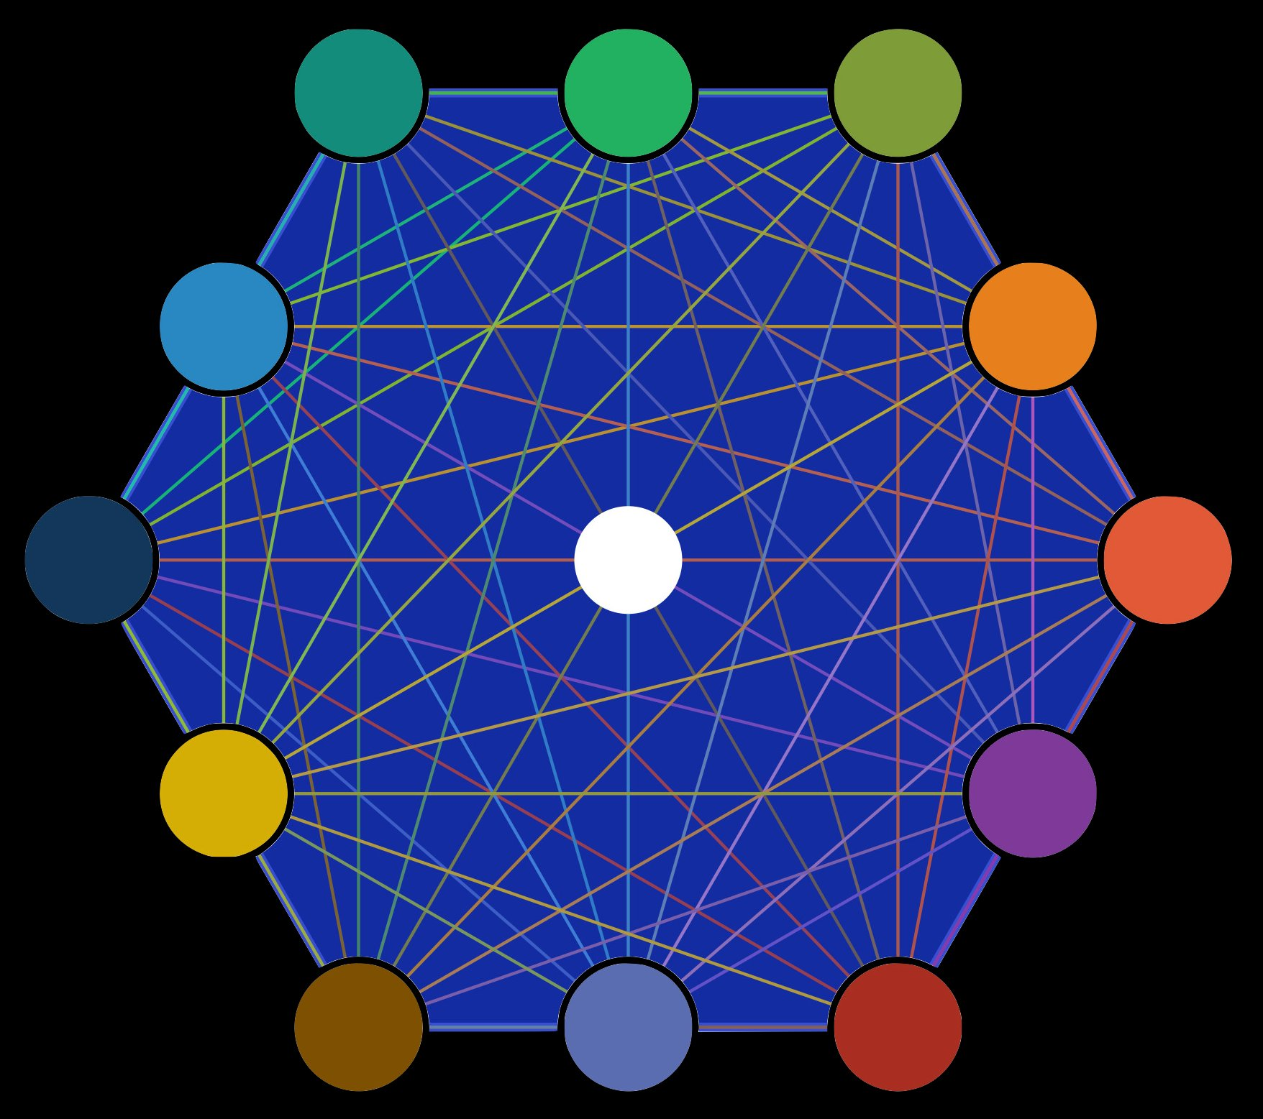
12 POINTS OF
Good Governance
A Framework for Civic Leadership and Community Engagement
civicsphere.ai | © Civic Sphere

Slide 2
ABOUT THIS FRAMEWORK
Good governance is not a destination — it is a practice.
01
02
03
The 12 points outlined in this framework represent the foundational principles that define effective, legitimate, and democratic governance at every level — from neighborhood associations to national institutions.
Each principle is both an aspiration and a standard — a guide for civic leaders working to build the communities they believe in, and a benchmark against which existing institutions can be measured and held accountable.
Civic Sphere is built to support each of these principles in practice.
04
05
06
07
08
09
10
11
12
civicsphere.ai | © Civic Sphere

Slide 3
01
Rule of Law
Laws apply equally to everyone, including those in power, and are enforced fairly and impartially.
IN DEPTH
CIVIC SPHERE CONNECTION
The rule of law is the cornerstone of any functioning democracy. No individual, institution, or government body is above the law. Laws must be publicly known, consistently applied, and independently enforced by a judiciary free from political interference. When the rule of law breaks down, corruption flourishes, rights erode, and public trust collapses.
Civic Sphere helps citizens understand their legal rights and the mechanisms available to hold institutions accountable. Through AI-assisted civic education, users can explore how laws are made, challenged, and reformed.
12 Points of Good Governance | civicsphere.ai | © Civic Sphere

Slide 4
02
Transparency
Government decisions, processes, and finances are open and accessible to the public.
IN DEPTH
CIVIC SPHERE CONNECTION
Transparency is the obligation of governments and public institutions to make their operations, decisions, and use of resources visible to the people they serve. This includes open budget processes, accessible public records, and clear communication about policy rationales. Digital tools have dramatically expanded the possibilities for transparency.
Civic Sphere aggregates and surfaces publicly available government data, meeting records, and budget information in accessible formats — enabling more citizens to hold institutions accountable and participate in informed civic dialogue.
12 Points of Good Governance | civicsphere.ai | © Civic Sphere

Slide 5
03
Accountability
Leaders and institutions are answerable for their actions and decisions to the people they serve.
IN DEPTH
CIVIC SPHERE CONNECTION
Accountability requires that those who hold power can be questioned, evaluated, and held responsible for their conduct. It operates through multiple channels: electoral, legal, administrative, and social accountability. Accountability without transparency is impossible — together they form the essential feedback loop of democratic governance.
Civic Sphere provides tools for tracking elected officials' voting records, policy positions, and public commitments — creating a persistent record that citizens can reference when evaluating their representatives.
12 Points of Good Governance | civicsphere.ai | © Civic Sphere

Slide 6
04
Participation
Citizens have meaningful opportunities to engage in decision-making processes that affect their lives.
IN DEPTH
CIVIC SPHERE CONNECTION
Genuine participation goes far beyond voting every few years. It encompasses public comment processes, community meetings, participatory budgeting, citizen advisory boards, and grassroots organizing. Meaningful participation requires that all voices — not just the loudest or most resourced — have real influence over outcomes.
At its core, Civic Sphere is a participation engine. The platform connects citizens to civic opportunities, simplifies engagement with public comment periods and elected officials, and provides the tools needed to participate effectively — not just symbolically.
12 Points of Good Governance | civicsphere.ai | © Civic Sphere

Slide 7
05
Consensus Orientation
Governance mediates differing interests to reach broad agreement on what is in the best interest of the community.
IN DEPTH
CIVIC SPHERE CONNECTION
Consensus orientation means governance processes are designed to surface diverse perspectives, facilitate genuine dialogue, and seek solutions reflecting the broadest possible common ground. In polarized environments, it provides an alternative to zero-sum politics — civic leaders who practice it build coalitions, not just majorities.
Civic Sphere's AI-facilitated engagement tools support constructive dialogue across difference. By helping identify areas of common ground and structure productive conversations around shared values, the platform enables consensus-building that leads to durable policy outcomes.
12 Points of Good Governance | civicsphere.ai | © Civic Sphere

Slide 8
06
Equity & Inclusiveness
All members of society, especially the most vulnerable, have opportunities to improve or maintain their wellbeing.
IN DEPTH
CIVIC SPHERE CONNECTION
Equity in governance means recognizing that fair treatment sometimes requires differentiated approaches. Inclusive governance actively works to ensure that historically excluded communities have genuine access to civic processes. Equity-centered governance asks not just 'what do we decide?' but 'who is in the room when we decide?'
Civic Sphere is built with equity as a design principle. The platform prioritizes accessibility, multilingual support, and outreach to underrepresented communities — ensuring the full diversity of community voices shapes public decisions.
12 Points of Good Governance | civicsphere.ai | © Civic Sphere

Slide 9
07
Effectiveness & Efficiency
Institutions produce results that meet the needs of society while making the best use of available resources.
IN DEPTH
CIVIC SPHERE CONNECTION
Good governance must deliver real results. Effectiveness means institutions successfully achieve their stated goals. Efficiency means achieving those results without waste or unnecessary bureaucratic burden. The most effective governance systems combine clear goals, adequate resources, skilled implementation, and ongoing evaluation.
Civic Sphere helps citizens evaluate whether their government institutions are delivering on their promises. By making performance data accessible and understandable, the platform supports evidence-based civic engagement.
12 Points of Good Governance | civicsphere.ai | © Civic Sphere

Slide 10
08
Responsiveness
Institutions and processes serve all stakeholders within a reasonable timeframe.
IN DEPTH
CIVIC SPHERE CONNECTION
Responsiveness means government institutions listen to and act on community needs in a timely and relevant manner. Responsiveness requires both structural mechanisms — clear channels for citizen input and reasonable response time standards — and a genuine cultural commitment to service over management.
Civic Sphere tracks response rates and turnaround times for constituent communications with elected officials and public agencies, creating a public record of institutional responsiveness — helping communities identify where improvement is needed.
12 Points of Good Governance | civicsphere.ai | © Civic Sphere

Slide 11
09
Strategic Vision
Leaders have a long-term perspective on governance and human development, grounded in historical, cultural, and social context.
IN DEPTH
CIVIC SPHERE CONNECTION
Strategic vision means the capacity to look beyond immediate pressures and electoral cycles to address long-term community needs. It separates incremental tinkering from transformative governance. Leaders with genuine strategic vision build broad coalitions and sustain commitment to long-term goals despite short-term pressures.
Civic Sphere supports strategic civic thinking by providing historical context for policy debates, scenario-planning tools for community visioning, and connections to civic leaders working on long-term community development.
12 Points of Good Governance | civicsphere.ai | © Civic Sphere

Slide 12
10
Ethical Leadership
Those in power demonstrate integrity, honesty, and a genuine commitment to the public good over personal interest.
IN DEPTH
CIVIC SPHERE CONNECTION
Ethical leadership is the foundation upon which all other principles depend. It requires more than avoiding illegal conduct — it demands honesty when inconvenient, transparency about conflicts of interest, and genuine respect for the dignity of all community members. High ethical standards produce better governance outcomes.
Civic Sphere provides tools for tracking conflicts of interest, financial disclosures, and ethical conduct records for public officials — supporting citizen oversight of ethical standards and enabling communities to demand the integrity their governance requires.
12 Points of Good Governance | civicsphere.ai | © Civic Sphere

Slide 13
11
Separation of Powers
Legislative, executive, and judicial functions are distributed to prevent concentration of power and protect against abuse.
IN DEPTH
CIVIC SPHERE CONNECTION
The separation of powers is democracy's most fundamental structural safeguard. By distributing authority among branches with mutual checks, democratic systems prevent the dangerous concentration of power. This extends beyond formal branches to include independent agencies, free press, and civil society organizations.
Civic Sphere educates citizens about the structure of democratic institutions and the roles of each branch of government — building civic capacity to recognize and respond to threats to democratic institutions.
12 Points of Good Governance | civicsphere.ai | © Civic Sphere

Slide 14
12
Local Power
Decisions are made at the most local level possible, empowering communities rather than centralizing all authority.
IN DEPTH
CIVIC SPHERE CONNECTION
Local power holds that governance decisions should be made at the lowest level of authority capable of addressing the issue effectively. It reflects deep respect for local knowledge and community self-determination. Higher levels of government should support rather than supplant local capacity.
Civic Sphere is designed to strengthen local civic capacity — connecting citizens to their most immediate civic institutions, from neighborhood associations to city councils. By making local governance more accessible and participatory, the platform embodies local power in practice.
12 Points of Good Governance | civicsphere.ai | © Civic Sphere

Slide 15
Governance is everyone's responsibility.
The 12 points are not just principles for institutions — they are a call to action for every citizen. Civic Sphere exists to make that action possible.
EMPOWERING
CONNECTING
STRENGTHENING
Citizens with the knowledge and tools to participate meaningfully in democratic governance.
Communities across difference to build consensus and collective civic capacity.
Democratic institutions through transparency, accountability, and informed civic oversight.
civicsphere.ai | © Civic Sphere

